Slide 1


Department of electronics and communication engineering Skill oriented course Basics of python programming “20ECS02” 1st REVIEW
Project title : Snake game using python
Name :P.YAKSHA SAI
Section :ece-- B
Id num :20NU1A0486
Guided by :S. Prathap(CSE)

Slide 2
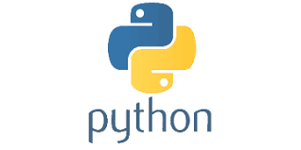
PYTHON AND IT’S HISTORY
Python is a high-level, interpreted, general-purpose programming language. Its design philosophy emphasizes code readability with the use of significant indentation.
Guido van Rossum began working on Python in the late 1980s as a successor to the ABC programming language and first released it in 1991 as Python 0.9.0.
Python 2.0 was released in 2000 and introduced new features such as list comprehensions, cycle-detecting garbage collection, reference counting, and Unicode support. Python 3.0, released in 2008, was a major revision that is not completely backward-compatible with earlier versions. Python 2 was discontinued with version 2.7.18 in 2020..
Python consistently ranks as one of the most popular programming languages.

Slide 3
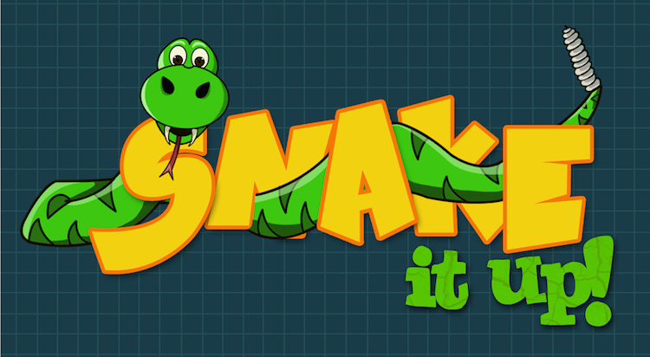
SNAKE GAME USING PYTHON PROGRAME
Snake Game is one of the traditional 2D game that is played by every Millennials.
In this game there is a snake who is in continuous motion.
Player has to make sure that snake do not hit the walls or shouldn’t collide in itself.
Played can control the snake with Right, Left, Bottom, Top keys.
The snake starts the moment in right direction by default.
There is n object on the screen referred to as ‘food’.
Every time snake collides with the food, the food disappeared and snake body size is increased.
There is a score for every successful collision of snake with the food.

Slide 4
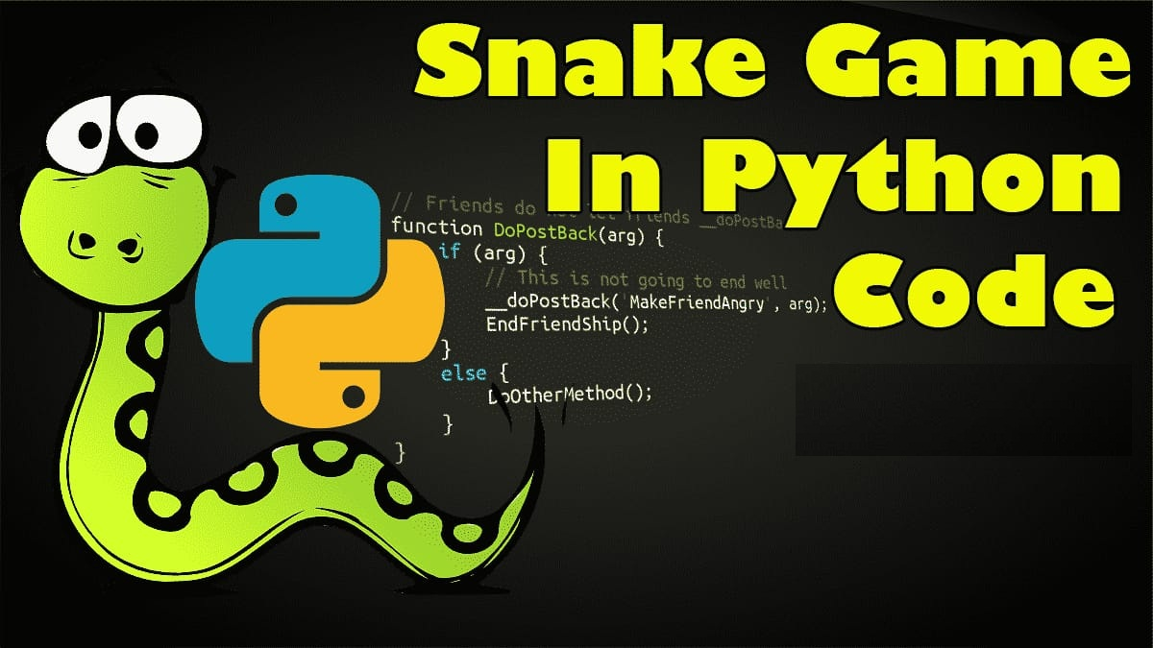
ABSTRACT
The first ever video game was developed in the year 1958 .
There are many genres under video games .
Board games have been played as a part of most cultures and religions throughout history (Senet from 3300-2700BC of Egypt is said to be the oldest board game known to have ever existed). .
For this paper, our aim is to digitize and optimize such abandoned board games and primordial video games using state-of-the-art programming languages (python) to make them available for today’s users.

Slide 5
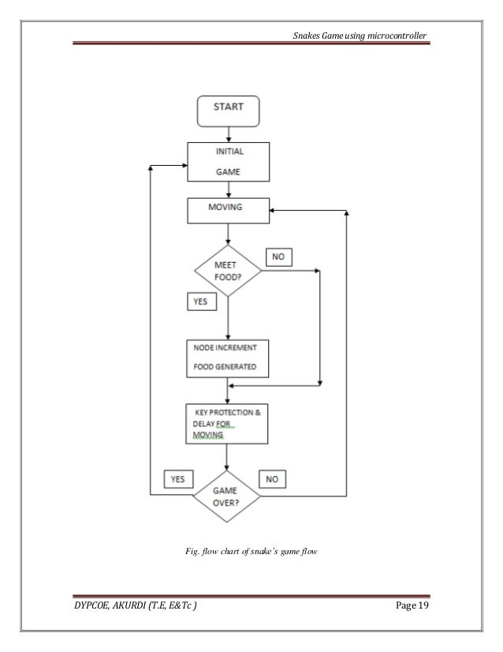
Data flow diagram

Slide 6
Source code
importing libraries
import turtle
import random
import time
#creating turtle screen
screen = turtle.Screen()
screen.title('DATAFLAIR-SNAKE GAME')
screen.setup(width =l1080 , height = 700)
screen.tracer(0)
turtle.bgcolor(‘LawnGreen')
##creating a border for our game
turtle.speed(5)
turtle.pensize(4)
turtle.penup()
turtle.goto(-310,250)
turtle.pendown()
turtle.color('black')
turtle.forward(600)
turtle.right(90)
turtle.forward(500)
turtle.right(90)
turtle.forward(600)
turtle.right(90)
turtle.forward(500)
turtle.penup()
turtle.hideturtle()

Slide 7
#score
score = 0
delay = 0.1
#snake
snake = turtle.Turtle()
snake.speed(0)
snake.shape('square')
snake.color("black")
snake.penup()
snake.goto(0,0)
snake.direction = 'stop'
#food
fruit = turtle.Turtle()
fruit.speed(0)
fruit.shape('circle')
fruit.color('red')
fruit.penup()
fruit.goto(30,30)
old_fruit=[]
#scoring
scoring = turtle.Turtle()
scoring.speed(0)
scoring.color("black")
scoring.penup()
scoring.hideturtle()
scoring.goto(0,300)
scoring.write("Score :",align="center",font=("Courier",24,"bold"))

Slide 8
#######define how to move
def snake_go_up():
if snake.direction != "down":
snake.direction = "up"
def snake_go_down():
if snake.direction != "up":
snake.direction = "down"
def snake_go_left():
if snake.direction != "right":
snake.direction = "left"
def snake_go_right():
if snake.direction != "left":
snake.direction = "right"
def snake_move():
if snake.direction == "up":
y = snake.ycor()
snake.sety(y + 20)
if snake.direction == "down":
y = snake.ycor()
snake.sety(y - 20)
if snake.direction == "left":
x = snake.xcor()
snake.setx(x - 20)
if snake.direction == "right":
x = snake.xcor()
snake.setx(x + 20)

Slide 9
# Keyboard bindings
screen.listen()
screen.onkeypress(snake_go_up, "Up")
screen.onkeypress(snake_go_down, "Down")
screen.onkeypress(snake_go_left, "Left")
screen.onkeypress(snake_go_right, "Right")
#main loop
while True:
screen.update()
#snake and fruit coliisions
if snake.distance(fruit)< 20:
x = random.randint(-290,270)
y = random.randint(-240,240)
fruit.goto(x,y)
scoring.clear()
score+=1
scoring.write("Score:{}".format(score),align="center",font=("Courier",24,"bold"))
delay-=0.001

Slide 10
## creating new_ball
new_fruit = turtle.Turtle()
new_fruit.speed(0)
new_fruit.shape('square')
new_fruit.color('red')
new_fruit.penup()
old_fruit.append(new_fruit)
#adding ball to snake
for index in range(len(old_fruit)-1,0,-1):
a = old_fruit[index-1].xcor()
b = old_fruit[index-1].ycor()
old_fruit[index].goto(a,b)
if len(old_fruit)>0:
a= snake.xcor()
b = snake.ycor()
old_fruit[0].goto(a,b)
snake_move()
##snake and border collision
if snake.xcor()>280 or snake.xcor()< -300 or snake.ycor()>240 or snake.ycor()<-240:
time.sleep(1)
screen.clear()
screen.bgcolor(‘LawnGreen')
scoring.goto(0,0)
scoring.write(" GAME OVER \n Your Score is {}".format(score),align="center",font=("Courier",30,"bold"))
time.sleep(delay)
turtle.Terminator()

Slide 11
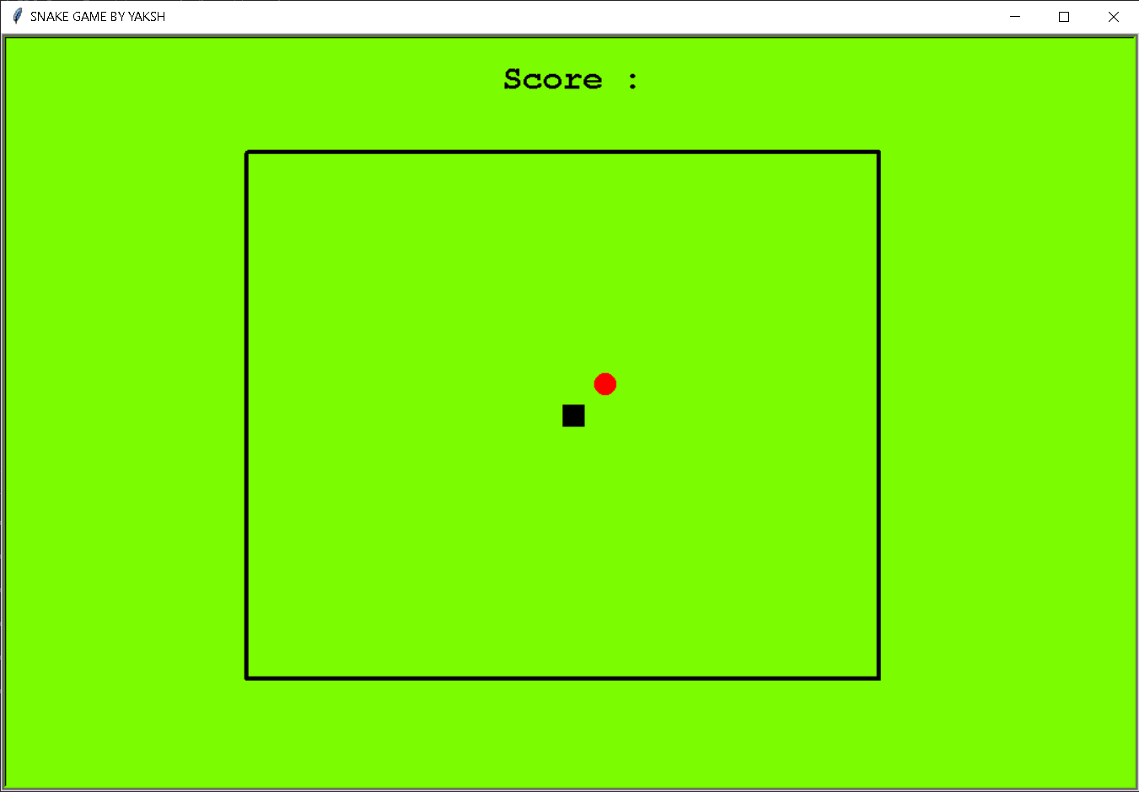
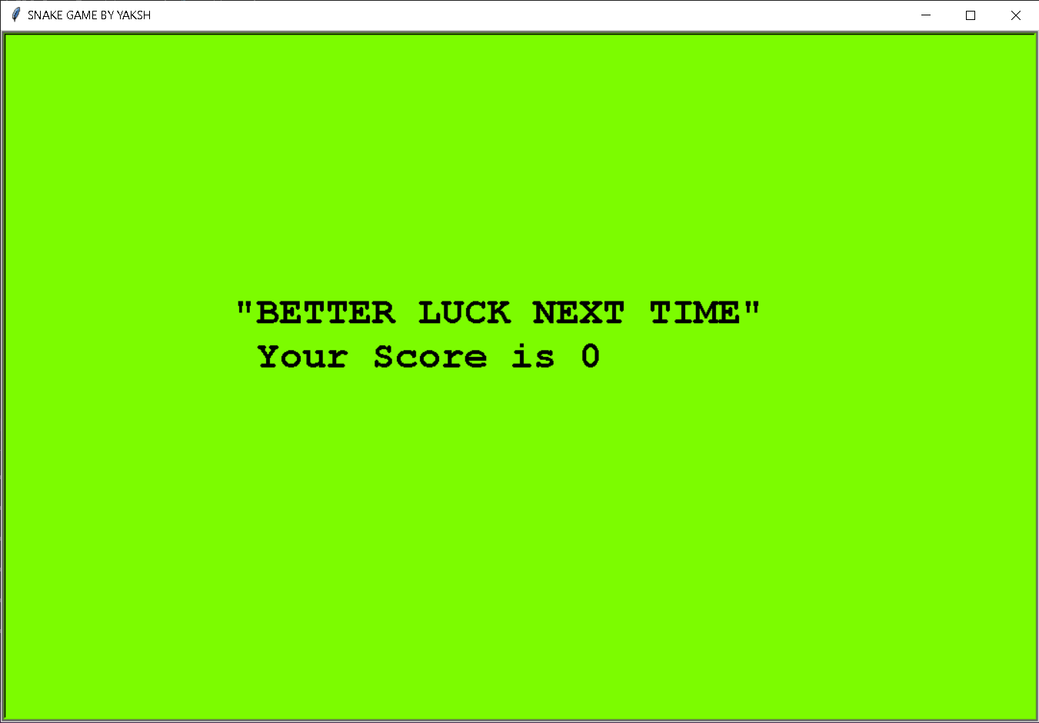
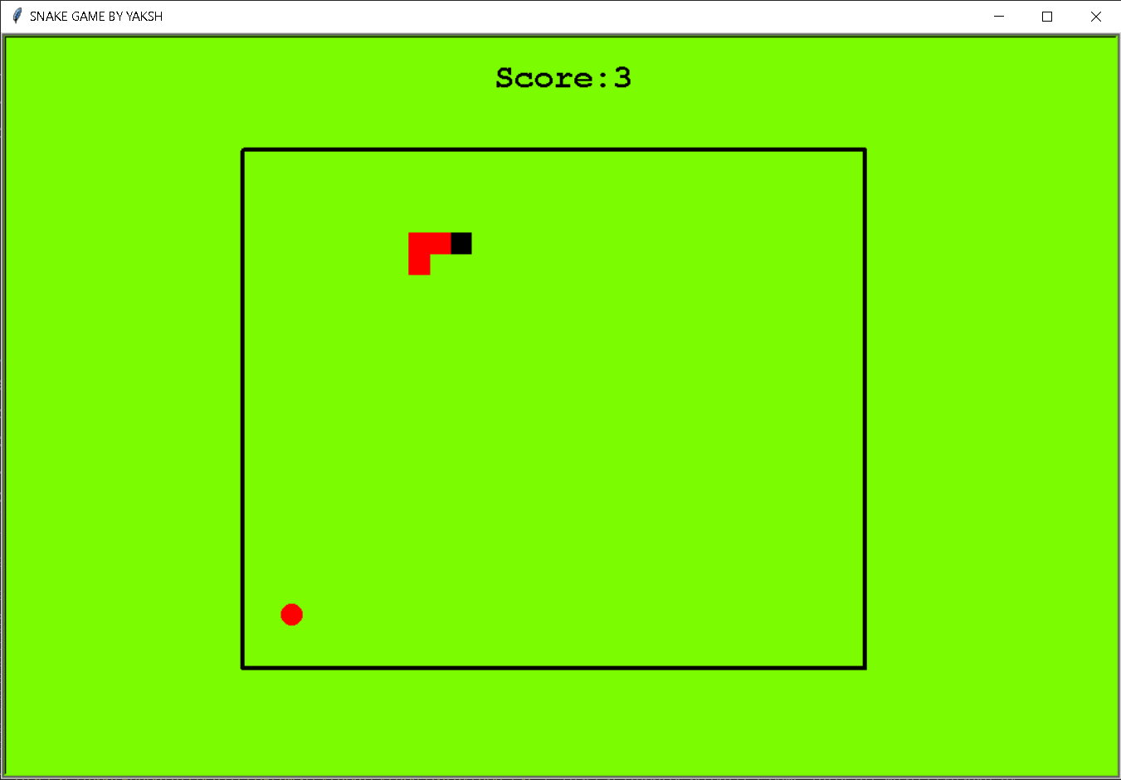

OUTPUT

Slide 12


